Slide 1
COMPARATIVE EVALUATION OF CRESTAL BONE CHANGES AND SOFT TISSUE OUTCOMES OF IMMEDIATE IMPLANTS VERSUS DELAYED IMPLANTS.

Slide 2
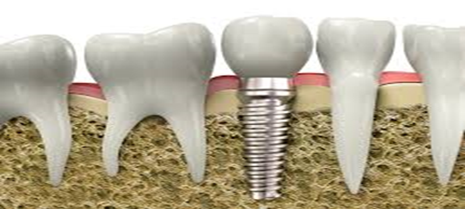
CONTENTS
INTRODUCTION
AIM & OBJECTIVES
REVIEW OF LITERATURE
MATERIALS & METHODS
RESULTS
DISCUSSION
CONCLUSION
REFERRENCES

Slide 3

INTRODUCTION
In 1952, Branemark discovered that osseointegration between titanium implants and bone

Slide 4
In the Third International Team for Implantology (ITI) consensus conference,
In the Type-1 procedure (immediate implant installation), implants are positioned in fresh extraction sockets, with the aim to engage the residual socket walls with the implant.
In the Type-2 procedure (early implant placement), implants are placed roughly 4–8 weeks after tooth extraction.
In the Type-3 protocol (early-delayed implant placement) the implants are placed once most of the dimensional changes in the alveolar ridge have ensued (12–16 weeks).

Slide 5
AIMS & OBJECTIVES
AIM OF THE STUDY:
To evaluate and compare buccolingual and interproximal crestal bone changes and soft tissue changes in immediate and delayed implants clinically and radiographically.
OBJECTIVES:
To evaluate buccolingual and interproximal bone changes.
To compare width of attached gingiva, Jemt Papilla Fill Index (PFI), Pink Esthetic Score (PES) and Probing Pocket Depth (PPD) after delayed and immediate implant placement.

Slide 6
REVIEW OF LITERATURE
Dr Beanish Bashir et al in 2019⁹ conducted a study to compare the soft‑tissue esthetic result of single implants positioned in fresh extraction sockets versus those placed in healed sockets. This cross sectional study consisted of 22 patients in which 12 implants were engaged immediately and 10 implants positioned conventionally. The esthetic consequence was objectively rated using the Pink Esthetic Score (PES) at 5-10 months range and it was established that both groups generated analogous esthetic scores.
Bali A et al. 2019 ¹⁰ conducted a study to inspect the crestal bone variations after immediate versus delayed dental implant placement. This prospective randomized comparative study was conducted in total of ten implant sites. Clinical parameters were documented at baseline (1 month), 3 months and 6 months which comprised Probing depth (PD), Radiographic Assessment (RA) for crestal bone changes. They concluded that there was noteworthy crestal bone loss in Group II (delayed implantation) at both mesial and distal surfaces during 3rd to 6th month’s observation period. Furthermore, a constant bone resorption was detected over the time in both the groups.

Slide 7
Mohindra K et al. in 2017¹ conducted a study to assess and compare buccolingual and interproximal crestal bone changes after delayed and immediate platform switched, acid etched implant (SLA), without the use of graft or barrier membrane clinically as well as radiographically. 14 implants were included in the study and clinical and radiographical parameters were investigated at baseline, 3 months and 6 months in immediate and delayed implant groups. It was concluded that there were significant variances between immediate and delayed groups when mean change from baseline to 6 months was compared, but there existed a non-significant difference in crestal bone changes.

Slide 8
Bhat et al in 2015¹⁶ conducted a study to evaluate the alteration in the peri-implant mucosal thickness and its effect on the marginal bone levels around dental implants treated in a conventional two-stage implant therapy. 33 implants were positioned in 20 subjects. The parameters evaluated were initial mucosal thickness, marginal bone levels on radiographs, pain, and exudation at the time of implant placement, and at cementation of final restoration, and at 6 months and 12 months. The peri-implant mucosal thickness reduced from implant placement till final restorations in both thick and thin biotypes, however, at 12 months there was a rebound of the tissue thickness, which was more in the thick biotype. They concluded that sites with thicker tissues preoperatively had a reduced bone loss and better rebound as compared to thinner tissues.

Slide 9
MATERIALS & METHODS
Source of data:
The study population was selected from the Out-Patient Section of the Department of Periodontics, Government Dental College and Hospital, Kadapa, India.
Study design:
20 endosseous platform switched implants of requisite lengths and diameters as per the selected site, provided in a sterile state with double packing.

Slide 10
Group-A: Included 10 sites receiving implants immediately in fresh extraction sockets. (Immediate implants)
Group-B: Included 10 sites receiving implants in healed/mature bone sockets. (Delayed implants)

Slide 11
INCLUSION CRITERIA
Patients with one or more missing teeth and with good oral hygiene.
Systemically healthy patients.
Patients with healthy soft tissue architecture.
Adequate bone height apical to the alveolus of the failing tooth i.e. ≥5mm.
Psychological acceptance of dental implants.

Slide 12
EXCLUSION CRITERIA
Patients with uncontrolled diabetes, radiation therapy in orofacial region or patients with systemic diseases.
Presence of vital anatomic structures near to a proposed implant site.
Smoking, alcohol abuse.
Pregnancy.
Sockets after traumatic extraction

Slide 13
The clinical parameters evaluated were
Width of attached gingiva,
Jemt Papilla Fill Index (PFI),
Pink Esthetic Score (PES) and
Probing Attachment Level (PAL).

Slide 14
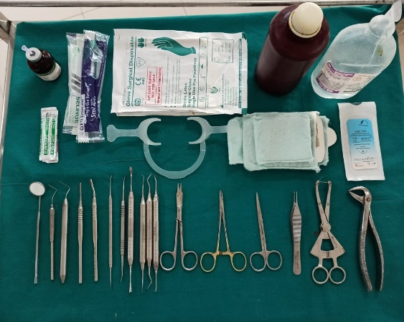
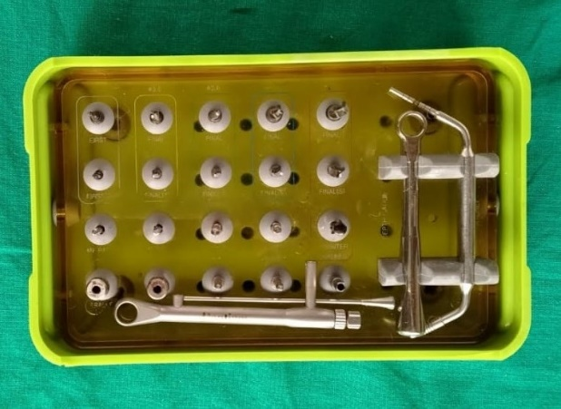
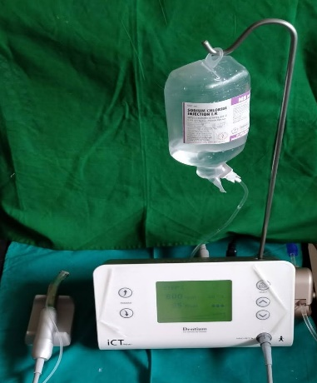
ARMAMENTARIUM

Slide 15
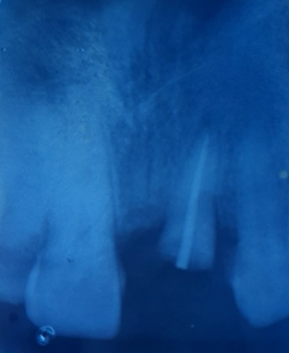
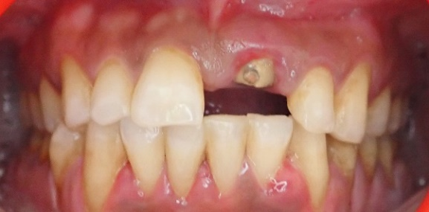
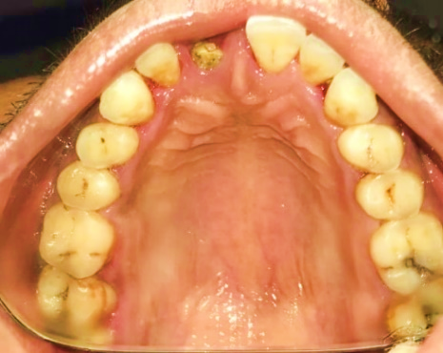
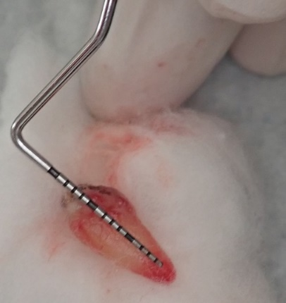
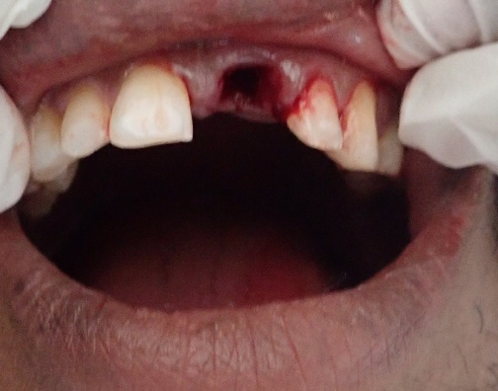
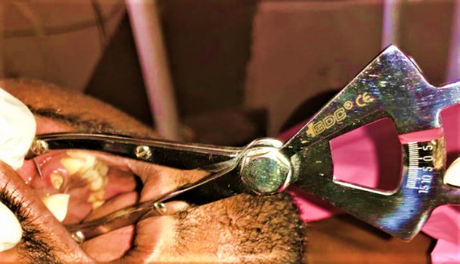
IMMEDIATE IMPLANT

Slide 16
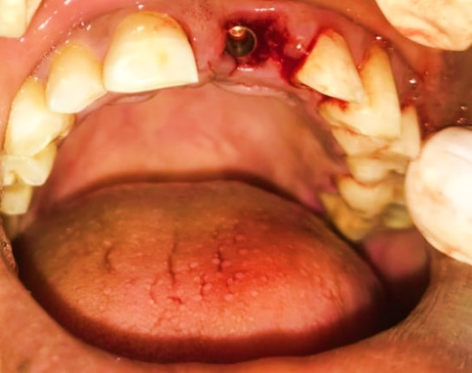
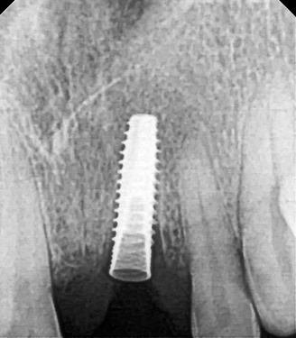
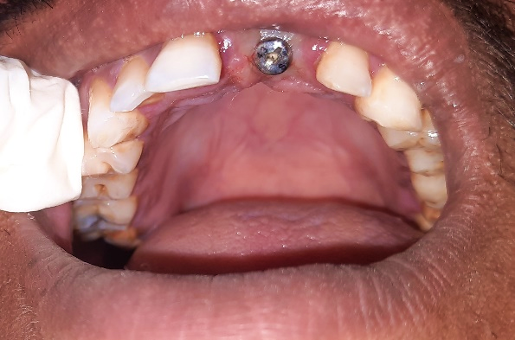
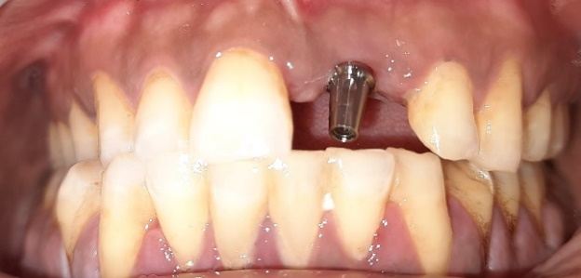
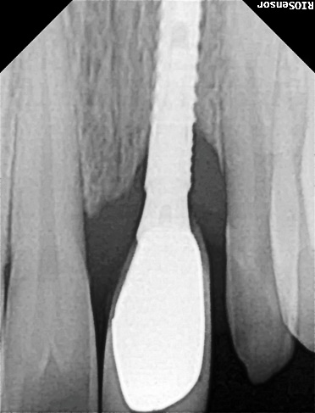
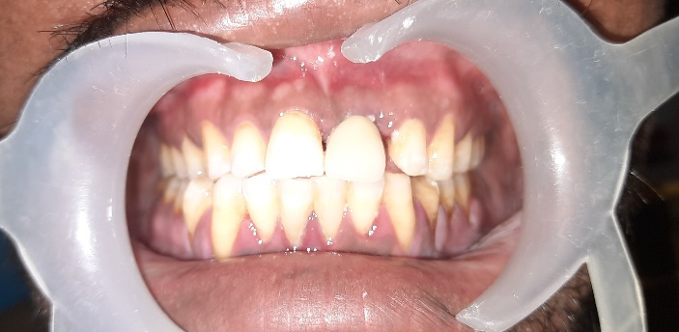
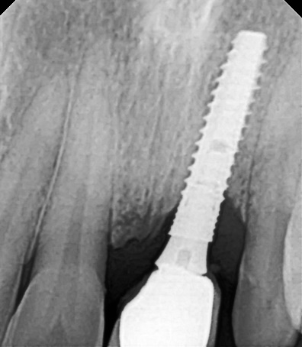
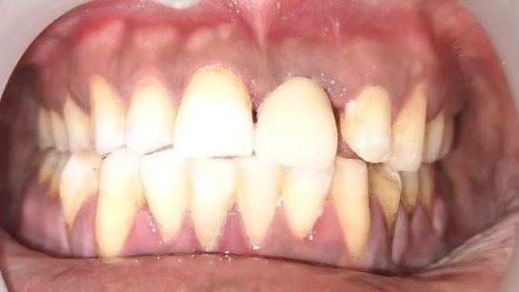

Slide 17
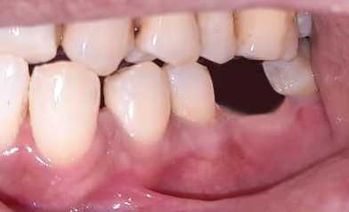
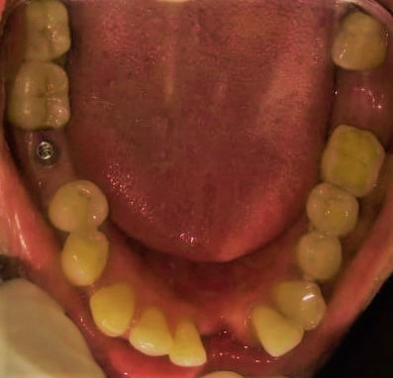
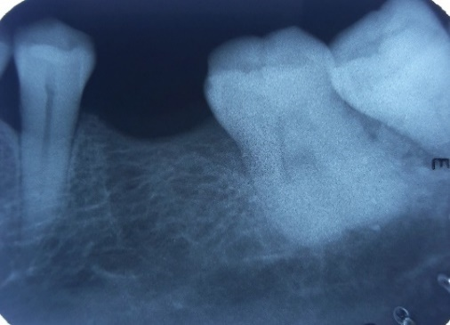
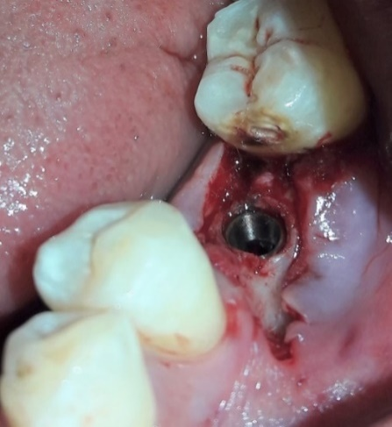
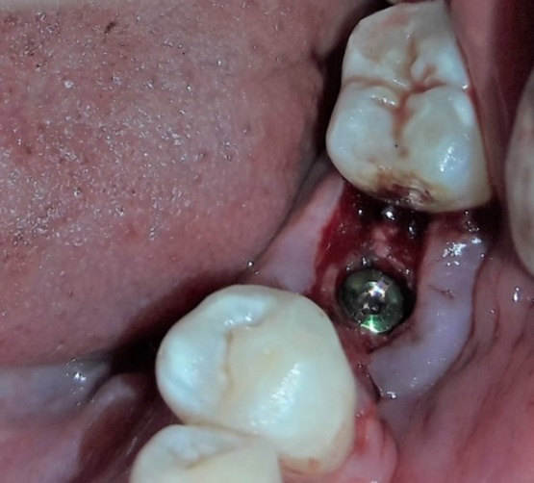
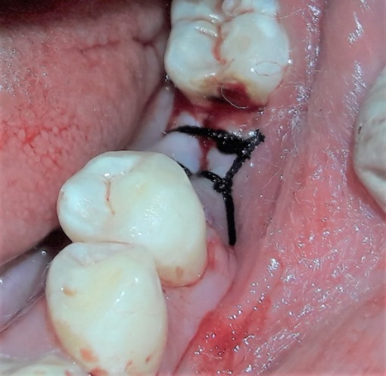
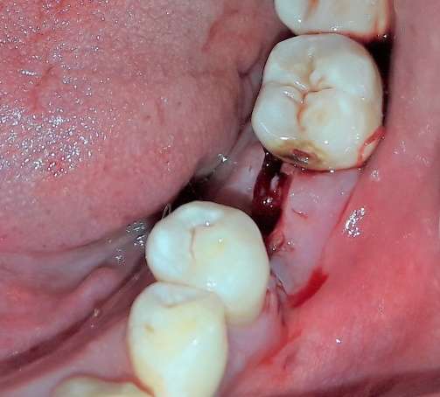
DELAYED IMPLANT

Slide 18
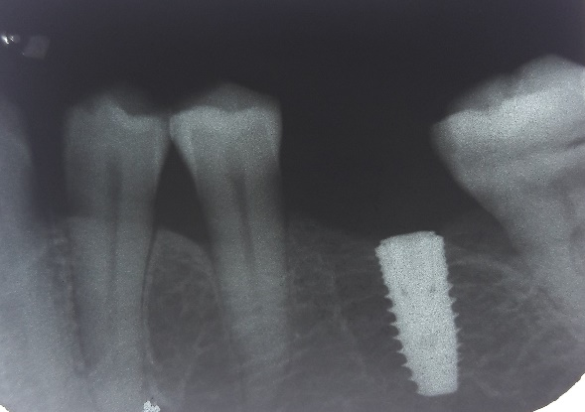
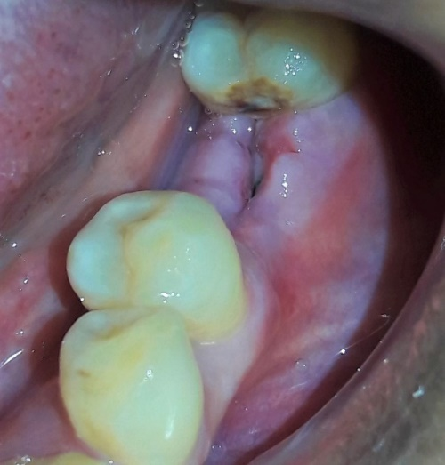
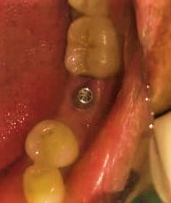
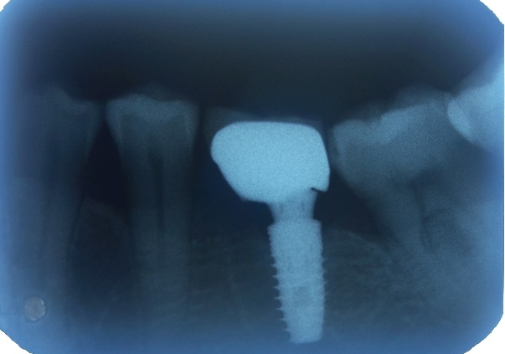
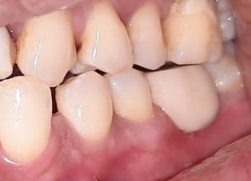
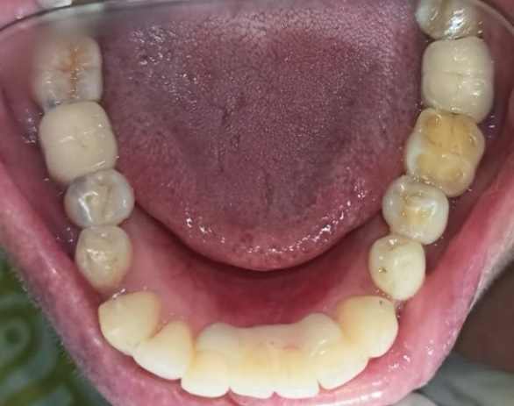
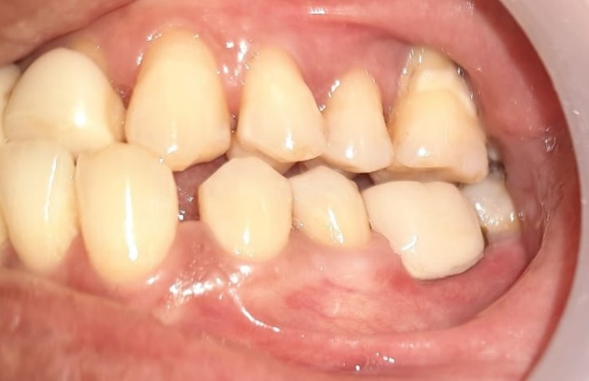
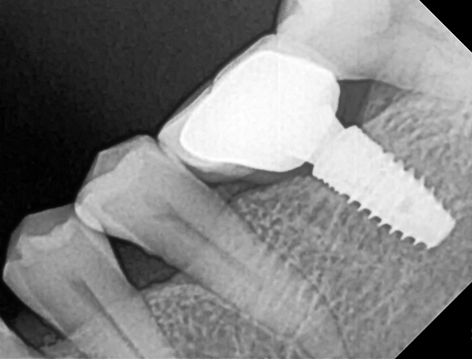

Slide 19
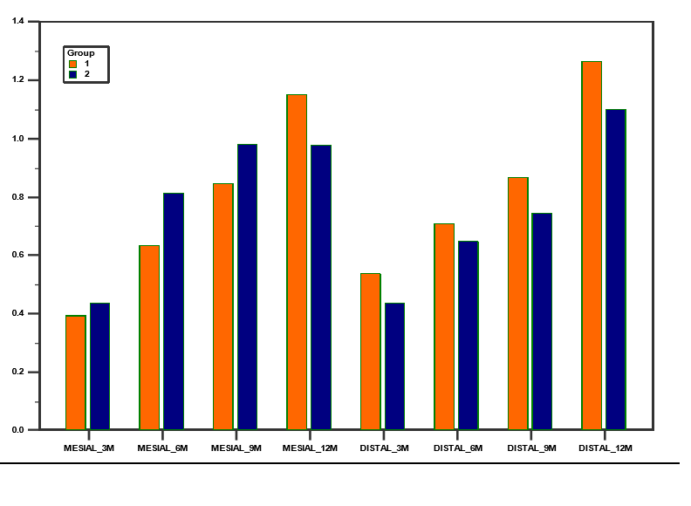
RESULTS
Intergroup comparison of interproximal crestal bone loss between Group-A and Group-B at different time intervals

Slide 20
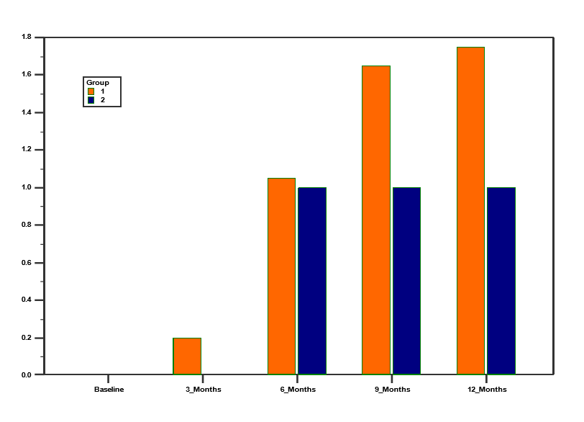
Intergroup comparison of Buccolingual width loss between Group-A and Group-B at different time intervals.

Slide 21
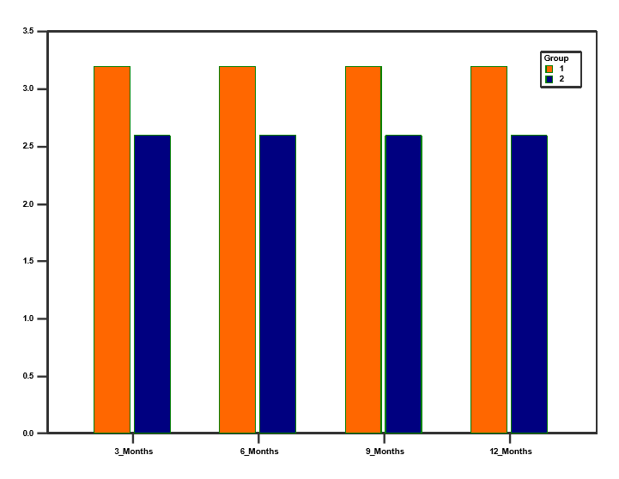
Intergroup comparison of width of keratinized mucosa in Group-A and Group-B at different time intervals

Slide 22
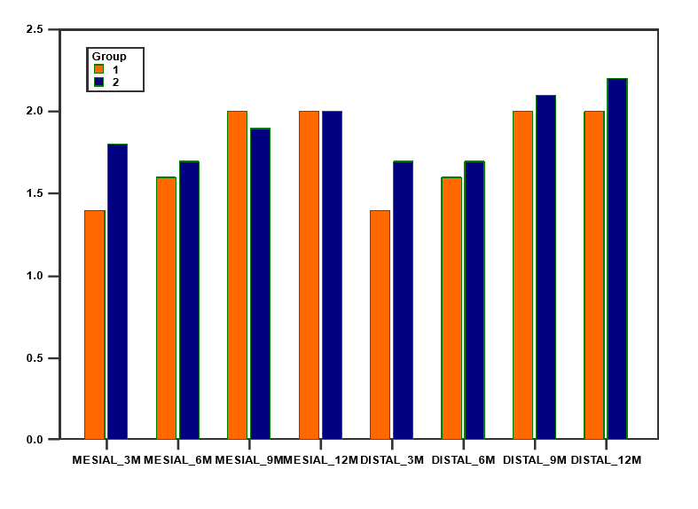
Intergroup comparison of Probing Attachment Level between Group-A and Group-B at different time intervals

Slide 23
Intergroup comparison of Jemt Papilla Fill Index between Group-A and Group-B at different time intervals

Slide 24
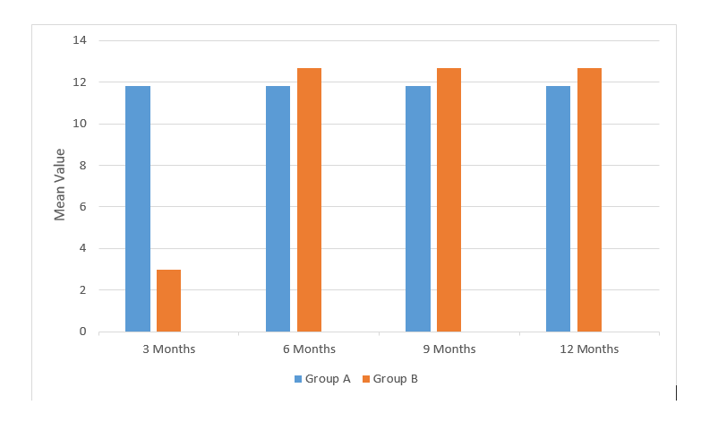
Intergroup comparison of Pink Esthetic Score between Group-A and Group-B at different time intervals

Slide 25
DISCUSSION
The impact of immediate implant placement on the buccal bone has yielded heterogeneous results, ranging from mean buccal bone resorption of 3.14– 0.0 mm. The reasons for this heterogeneity are very diverse, from lack of standardization in the preclinical models, use of different surgical protocols and implant systems and probably the inherent variability in the biological wound-healing process of the socket.
Araujo et al in 2005 conducted a study to evaluate dimensional alterations of the alveolar ridge that occurred following implant placement in fresh extraction sockets. They concluded that placement of an implant in the fresh extraction site failed to prevent the re-modeling that occurred in the walls of the socket. The resulting height of the buccal and lingual walls at 3 months was similar at implants and edentulous sites and vertical bone loss was more pronounced at the buccal than at the lingual aspect of the ridge. It was suggested that the resorption of the socket walls that occurs following tooth removal must be considered in conjunction with implant placement in fresh extraction sockets.

Slide 26
The mechanism by which platform switching can contribute to maintain the crestal bone height could be due to four reasons:
Shifting the inflammatory cell infiltrate inward and away from the adjacent crestal bone.
Maintenance of biological width and increased distance of IAJ from the crestal bone level.
The possible influence of micro-gap on the crestal bone is diminished.
Decreased stress levels in the peri-implant bone.⁵²
Baumgarten et al (2005) described the platform switching technique and its use in situations requiring shorter implants, where implants were placed in esthetic zones, and where a larger implant was desirable but prosthetic space was limited. They also stated that a sufficient tissue depth (approximately 3 mm or more) is necessary to accommodate an adequate biologic width. They concluded that platform switching helps in preventing the anticipated bone loss and also preserved crestal bone.

Slide 27
The pattern of coronal bone remodeling, with narrowing of buccolingual bone width was almost similar in both groups. Delayed group exhibited more marked osseous recontouring that probably began after tooth extraction and continued through the waiting period prior to implant placement. Similar results have been reported by Covani et al. (2003), Cornelini and Barone et al. (2004) who also observed significant reduction in buccolingual width between first and at the time of second surgery.

Slide 28
. Several studies like Langer B (1990), Landi L (2001) and Lee KH (2010) have indicated that the adequate width of keratinized mucosa for healthy tissues around dental implants is at least ≥2 mm.¹⁴ There was no change in width of keratinized mucosa observed at 3, 6, 9 and 12 months of observation period in both Group-A and Group-B. Similar results have been reported by Sanivarapu et al. [2010], Anand et al. [2013] who also reported that width of keratinized gingiva remained constant throughout the study.
Pellicer-Chover H et al (2013) found decrease in keratinized mucosa in both immediate and delayed implant groups over time. This was in disagreement with the present study.¹⁸

Slide 29
Clinical probing is regarded as an important and reliable diagnostic parameter in the continuous monitoring of both periodontal and peri-implant tissues as stated by Niklaus et al. (2003). As peri-implant tissues are more sensitive around implant according to Mombelli et al. [1997] so less force is applied during peri-implant probing (0.2–0.3N).
Similar findings were reported by Bali A et al. (2019), Tonetti M.S et al. (2016).
An interesting observation was the decreasing trend in probing depth between 1 month of follow-up (3.90mm) and study termination (3.46mm). The pocket shrinkage was reported by Proussaefs et al. (2002) from 3.6mm at 3 months to 3.2 mm at 12 months of follow-up.

Slide 30
When studies evaluated the papilla ﬁll according to the papilla index proposed by Jemt T (1997), there was a consistent ﬁnding that a gradual ﬁll of the interproximal spaces will occur during a 1-year observation period in most cases Kan JY (2007), whereas papilla loss (> 1 mm) was found only in 4% and 16% of mesial and distal papillae, respectively Cosyn J et al. (2011). These results are in agreement with a long-term study recently published by Kan et al. (2011).

Slide 31
The PES integrates seven variables for a simple and clinically practiced evaluation with a 2–1–0 score rating system.
This finding was also in agreement with that of previous studies showing that papilla fullness was independent of the time of implant surgery relative to tooth extraction i.e., Pour et al. (2018), Raes et al. (2011), Rompen et al. (2007) . In other words, based on several studies, interdental papillary height depends on the bone peak of adjacent tooth, and time of implant placement has no effect on bone level Lindeboom et al. (2006).
Also according to the systematic review by Yan Q et al. (2016), no significant difference in the esthetic outcomes were reported following immediate as compared with conventional implant placement.

Slide 32
SUMMARY & CONCLUSION
There was a significant reduction in buccolingual width from baseline to 12 month observation period.
Interproximal crestal bone loss was more in immediate implant group when compared to delayed group from baseline to 12 months observation period. Although the delayed implants exhibited smaller bucco-lingual bone widths upon the ﬁrst measurement, as records of bone width were taken at the time of extraction, it could be sure that the smaller width is wholly due to the waiting period before implantation, although it can be speculated that early remodeling may start immediately following tooth extraction and continue, non-uniformly, even after delayed implant placement.

Slide 33
Width of keratinized mucosa, Jemt papilla fill index and pink esthetic scores remained constant throughout the study in both immediate and delayed implant procedures. Both the procedures yielded comparable esthetic results.
On comparing probing attachment level there was no significant difference between immediate and delayed groups but there was an increase in probing attachment level in both the groups during observation period but there was significant difference in immediate implant group when compared from 3 months to 12 months.

Slide 34
LIMITATIONS
Limited sample size
Short follow-up period.
Implant placed irrespective of anterior or posterior region
Analysis was done on a vertical level and did not take into consideration the buccolingual volume of the papilla while assessing Jemt Papilla Fill Index.
An important limitation of the present study is that our results may not fully reﬂect daily practice any more. Indeed, today most clinicians would probably ﬁll the bone gap between the alveolar crest and the implant shoulder following IIT using a grafting material. Similarly, surgeons would probably use more connective tissue grafts in order to condition the soft tissues following either treatment strategy.

Slide 35
REFERENCES
Bashir, B., Jan, S., & behal, R. Evaluation of Soft tissue around Single-tooth Implant Crowns, Immediate placement versus Conventional placement. IOSR-JDMS 2019 Jun;18:34-37.
Bali A, Jindal M, Goel A, Gupta V, Dadwal A, Chauhan S. Comparative evaluation of clinical and radiographical outcomes of immediate versus delayed dental implant placement: A prospective study. Indian Journal of Dental Sciences. 2019 Jul 1;11(3):133.
Bhat PR, Thakur SL, Kulkarni SS. The influence of soft tissue biotype on the marginal bone changes around dental implants: A 1-year prospective clinico-radiological study. Journal of Indian Society of Periodontology. 2015 Nov;19(6):640.
Mohindra K (2017) Comparative evaluation of crestal bone changes after delayed and immediate implant placement. Dent Implants Dentures 2:120.
Buser D, Sennerby L, De Bruyn H. Modern implant dentistry based on osseointegration: 50 years of progress, current trends and open questions. Periodontology 2000. 2017 Feb;73(1):7-21

